Slide 1



Project Introduction
1
Project Name
Insurance Analytics
Project Code – P775
2
Modules
Excel
Tableau
Power BI
SQL

Slide 2


Meet Our Team :
Samrat Jha
Sowmiyasri B
Shivani Ghongatei
Aryan Zende
Hari prasad Bunga
Ivin George

Slide 3
Project Goal :
Branch dashboard is to discuss new and renewal business number with each branchs.
This Dashboard will be discussed between corporate team and individual
Branch heads.
Discuss Performance metrics in the branch.
Overall Performance summary
Detailed branch performance
Key Insights and action items
Summary of new, cross sell and renewal business numbers
of each branch

Slide 4
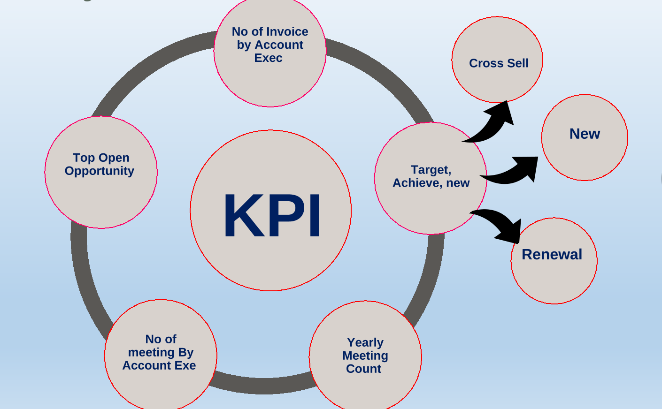
KPI Analysis :

Slide 5
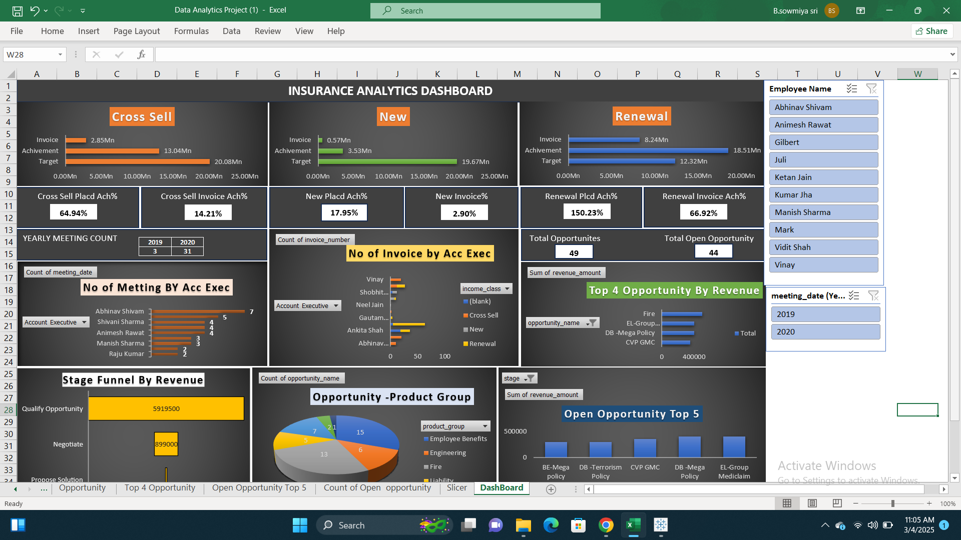
Excel Dashboard

Slide 6
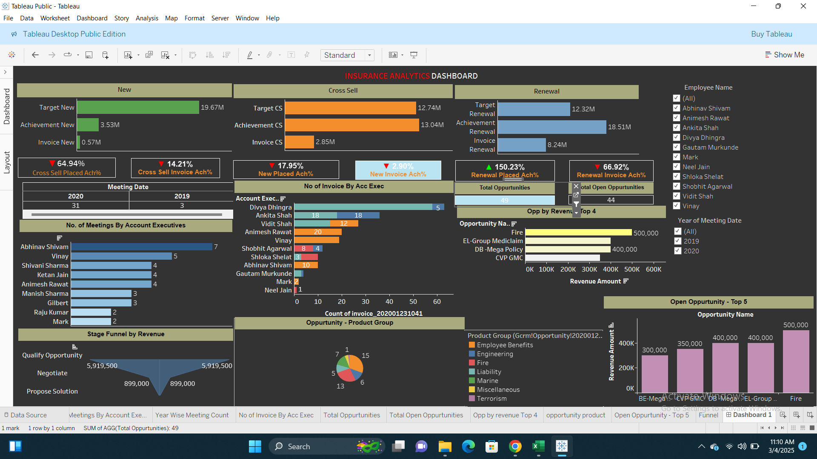
Tableau Dashboard

Slide 7
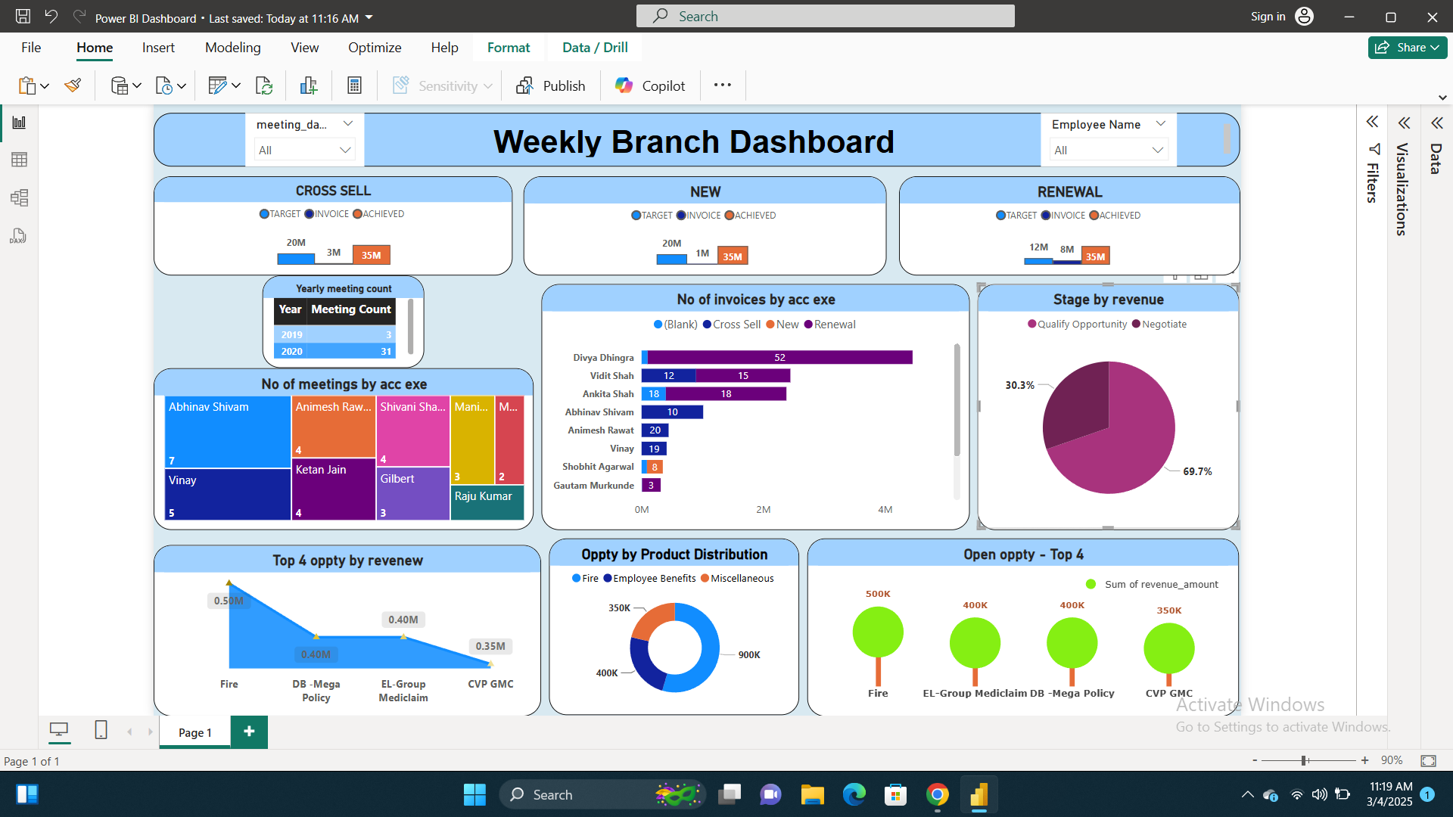
Power BI Dashboard

Slide 8
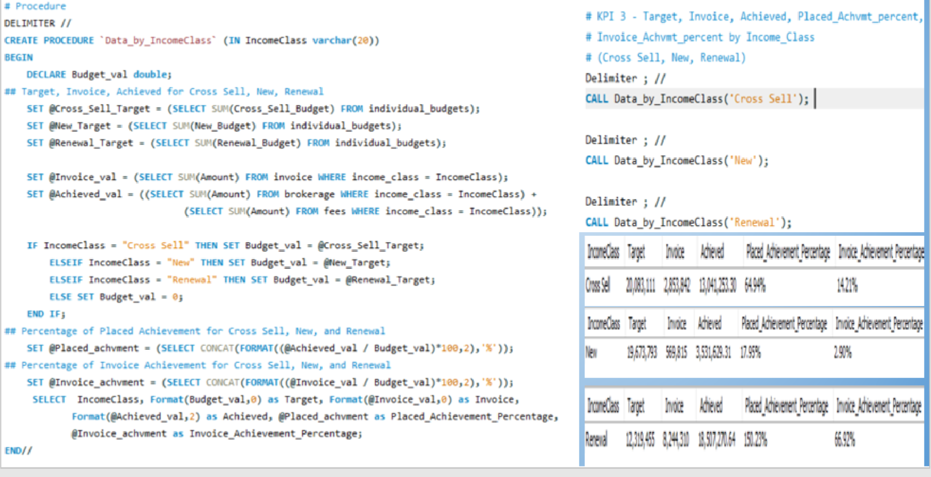
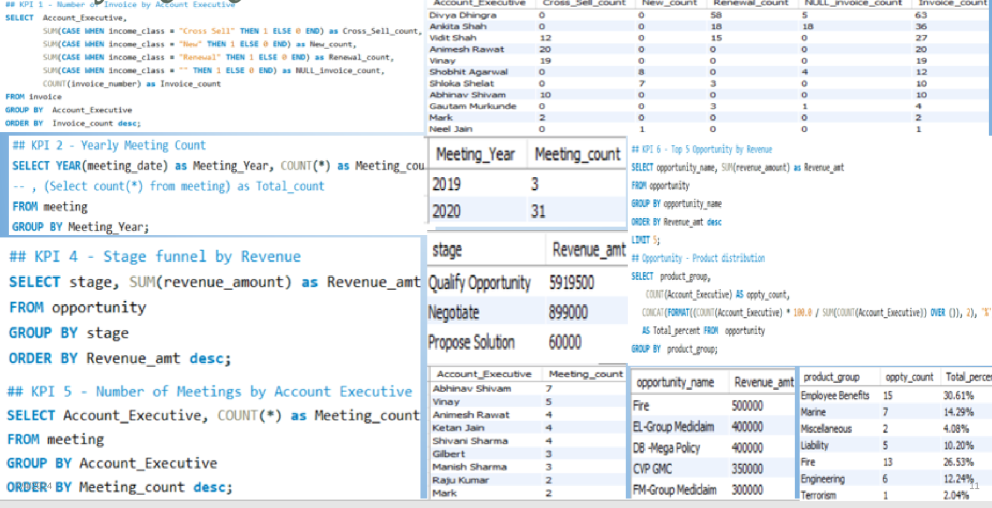
Sql Queries :

Slide 9
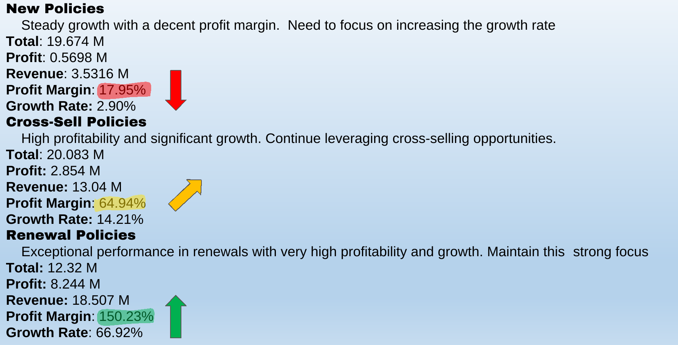
Conclusion :

Slide 10



Recommendations and Next Steps :
Enhance Customer Service
Market Analysis and Adaptation
Implement AI-driven chatbots for 24/7 customer support.
Train staff on customer engagement and conflict resolution.
Conduct market research to identify customer needs and preferences.
Adjust strategies based on competitive analysis and market trends.
Expand Product Offerings
Employee Engagement
Introduce new insurance products tailored to emerging markets.
Bundle products for better value to customers.
Foster a positive work environment to boost employee morale.
Introduce employee recognition programs to retain top talent.
Increase Sales and Retention
Enhance Operational Efficiency
Launch personalized marketing campaigns based on customer data.
Introduce loyalty programs to reward long-term customers.
Launch personalized marketing campaigns based on customer data.
Introduce loyalty programs to reward long-term customers.

Slide 11


